Slide 1

Project
Progress
Handwriting Recognition - Group 1

Slide 2
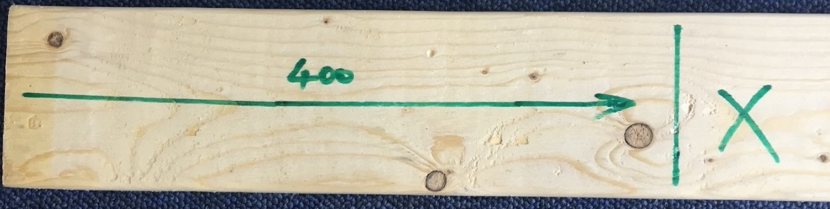
The system flow
The handwriting recognition system
Input image
Pre-processing
Symbol Classification
(CNN Model)
Digit Classification
(MNIST)
output image
Original image
Output image
Recognised and classified all symbols
Identified cut line, dimension line and piece to be discarded.

Slide 3

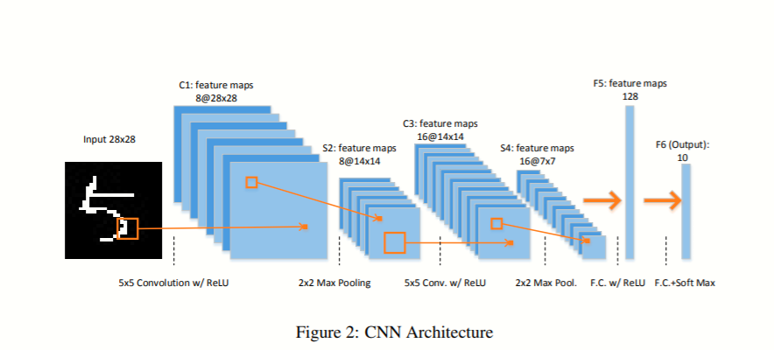


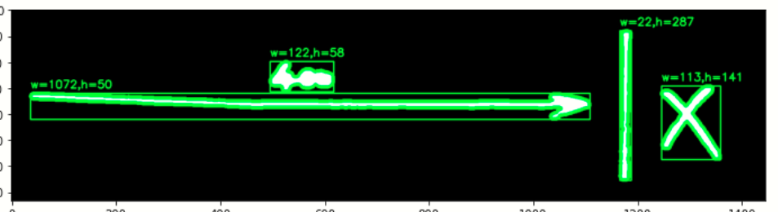
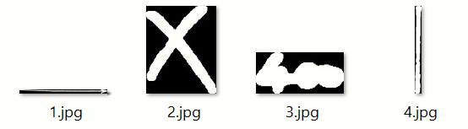
Current Results
Input image
Pre-processing
Symbol Classification
(CNN Model)
Pre-processed image
The CNN model
Original image
The datasets created by ourselves, which contains 770 images and the accuracy of this model is 97%.
This is test result for “X” symbol.

Slide 4

Next steps and related issues
Digit Classification
(MNIST)
Output Image
single digit recognition (digits lie very close to each other);
interpret digits as single number
how to split multiple digits to singles ones that can be recognized by the model.

Slide 5
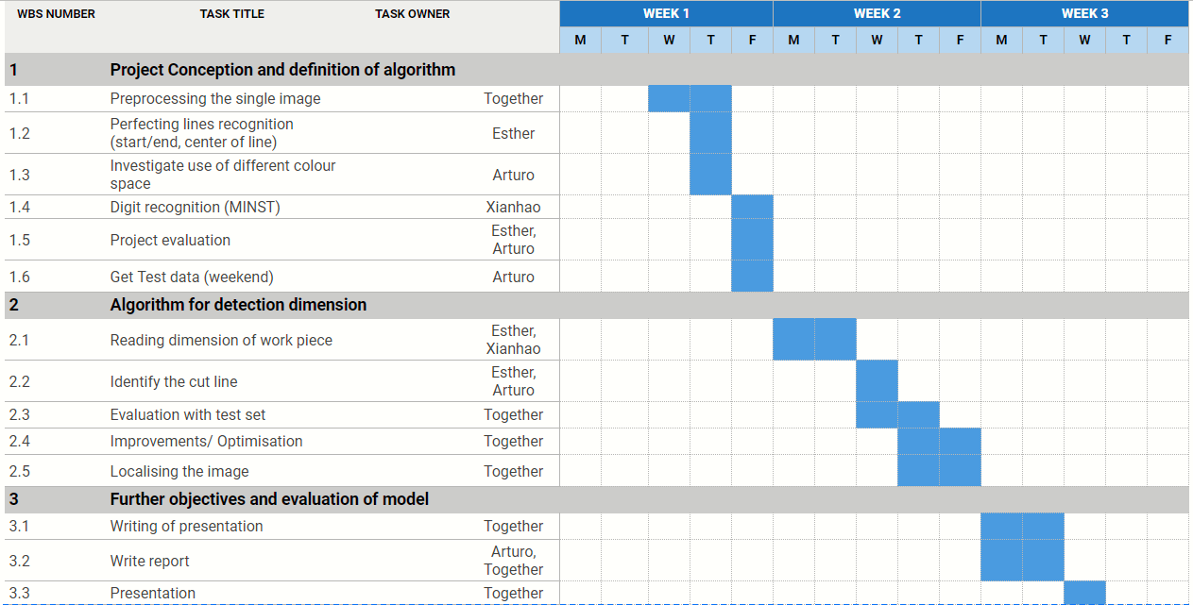
Project Plan
Overall some steps within the project plan have been rearranged according to our day to day working needs (most notably the work with MNIST dataset). However, we are up to date and should start testing soon.

